Slide 1
Metagenomics
2025.12.31
MIME-st
Jihyun Kim

Slide 2
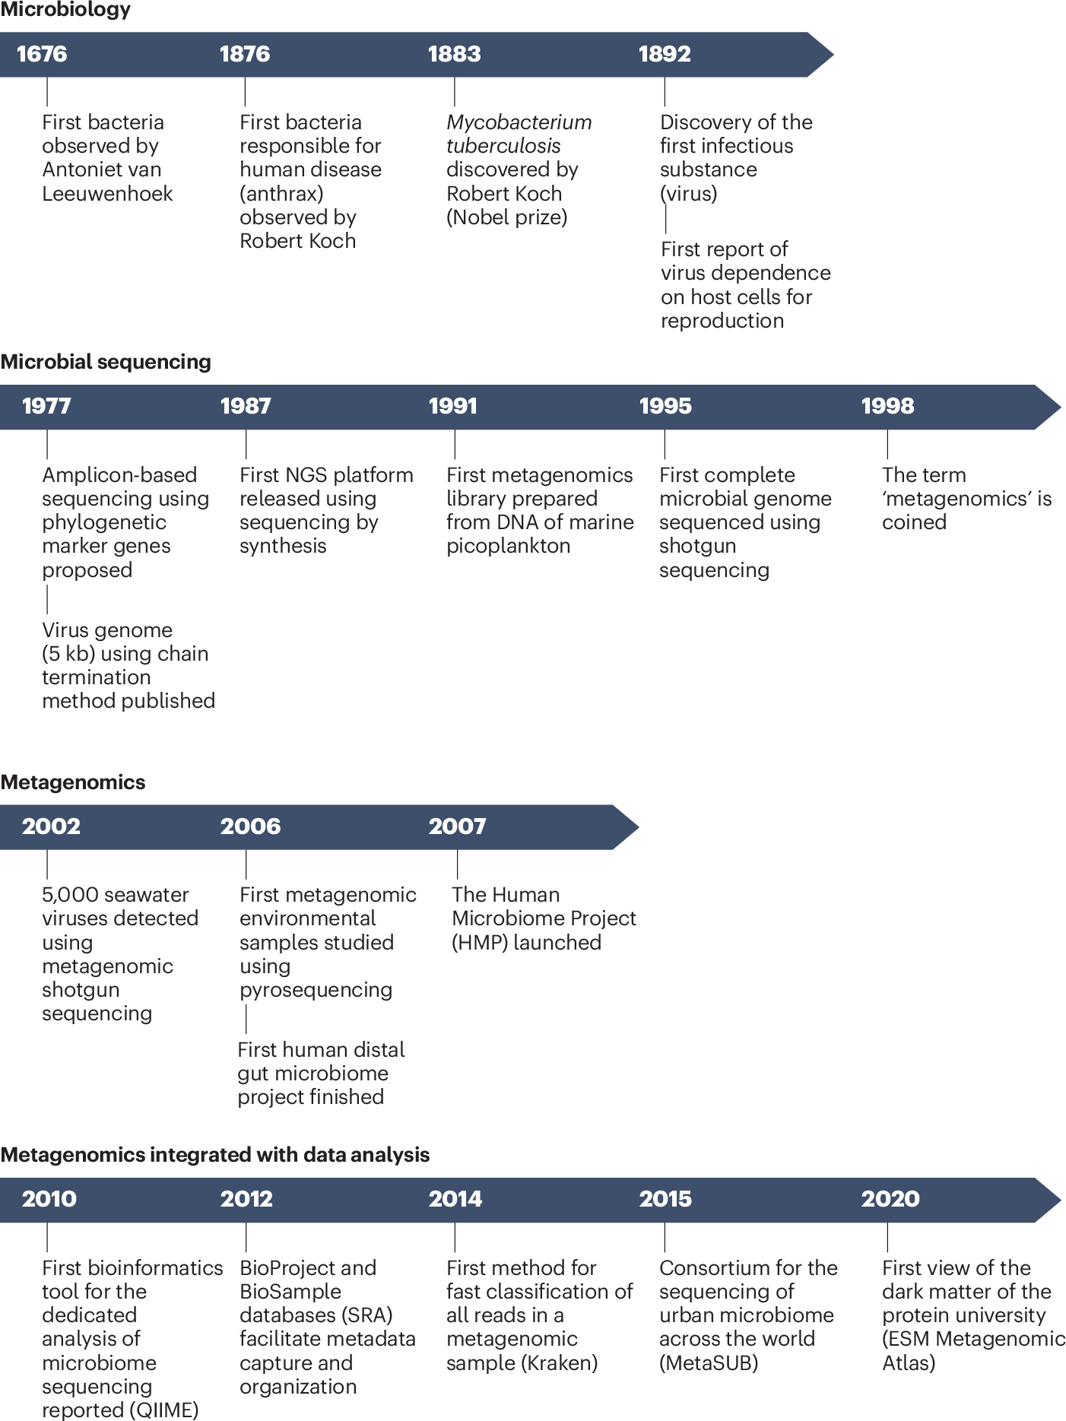
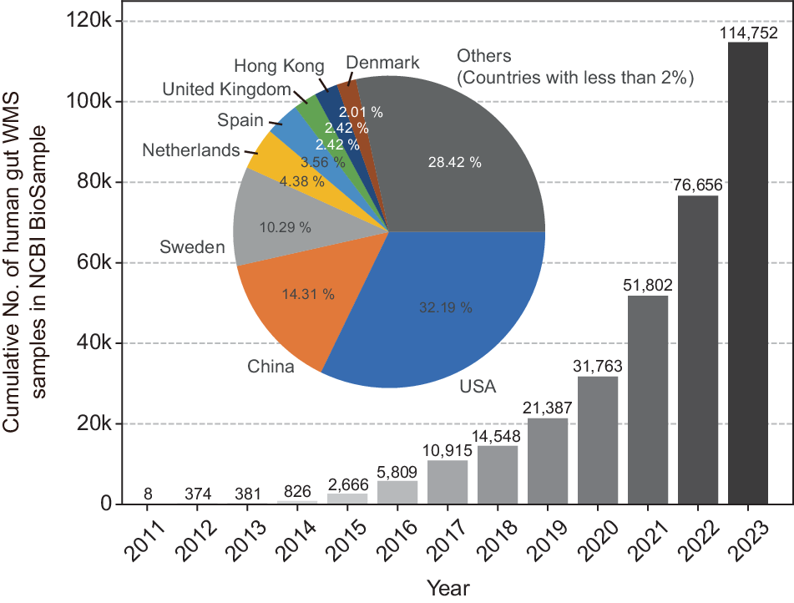
History of metagenomics
Human genome project
Human microbiome project
Liu, S., Rodriguez, J.S., Munteanu, V. et al. Analysis of metagenomic data. Nat Rev Methods Primers 5, 5 (2025). https://doi.org/10.1038/s43586-024-00376-6
Kim, N., Ma, J., Kim, W. et al. Genome-resolved metagenomics: a game changer for microbiome medicine. Exp Mol Med 56, 1501–1512 (2024). https://doi.org/10.1038/s12276-024-01262-7

Slide 3
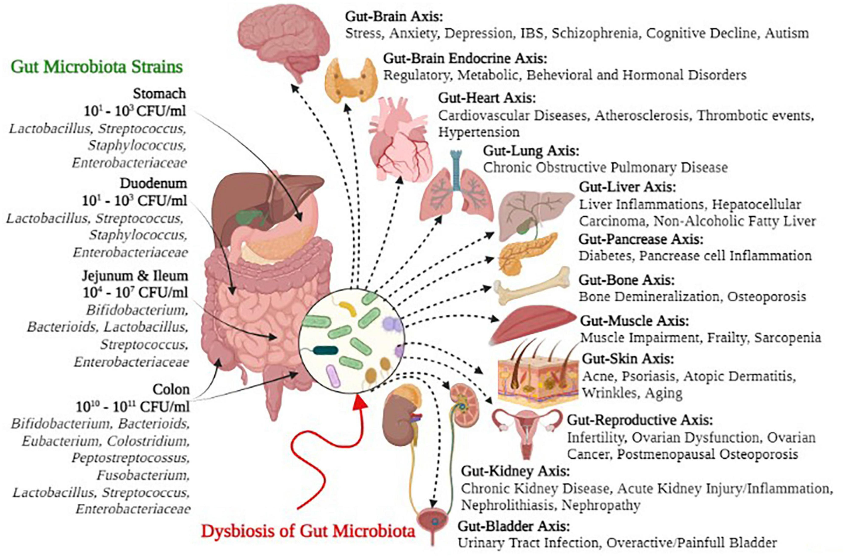
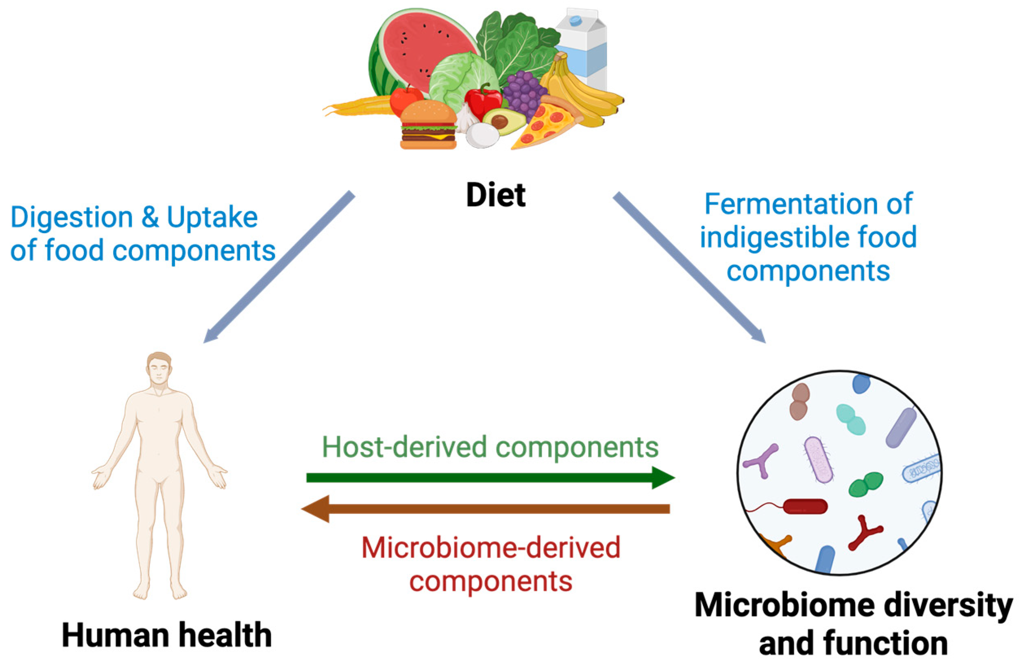
Gut microbiome and its association with host health
Bui, T.P.N. The Human Microbiome as a Therapeutic Target for Metabolic Diseases. Nutrients 2024, 16, 2322. https://doi.org/10.3390/nu16142322
Afzaal, M., et al. (2022). "Human gut microbiota in health and disease: Unveiling the relationship." Frontiers in Microbiology Volume 13 - 2022.

Slide 4
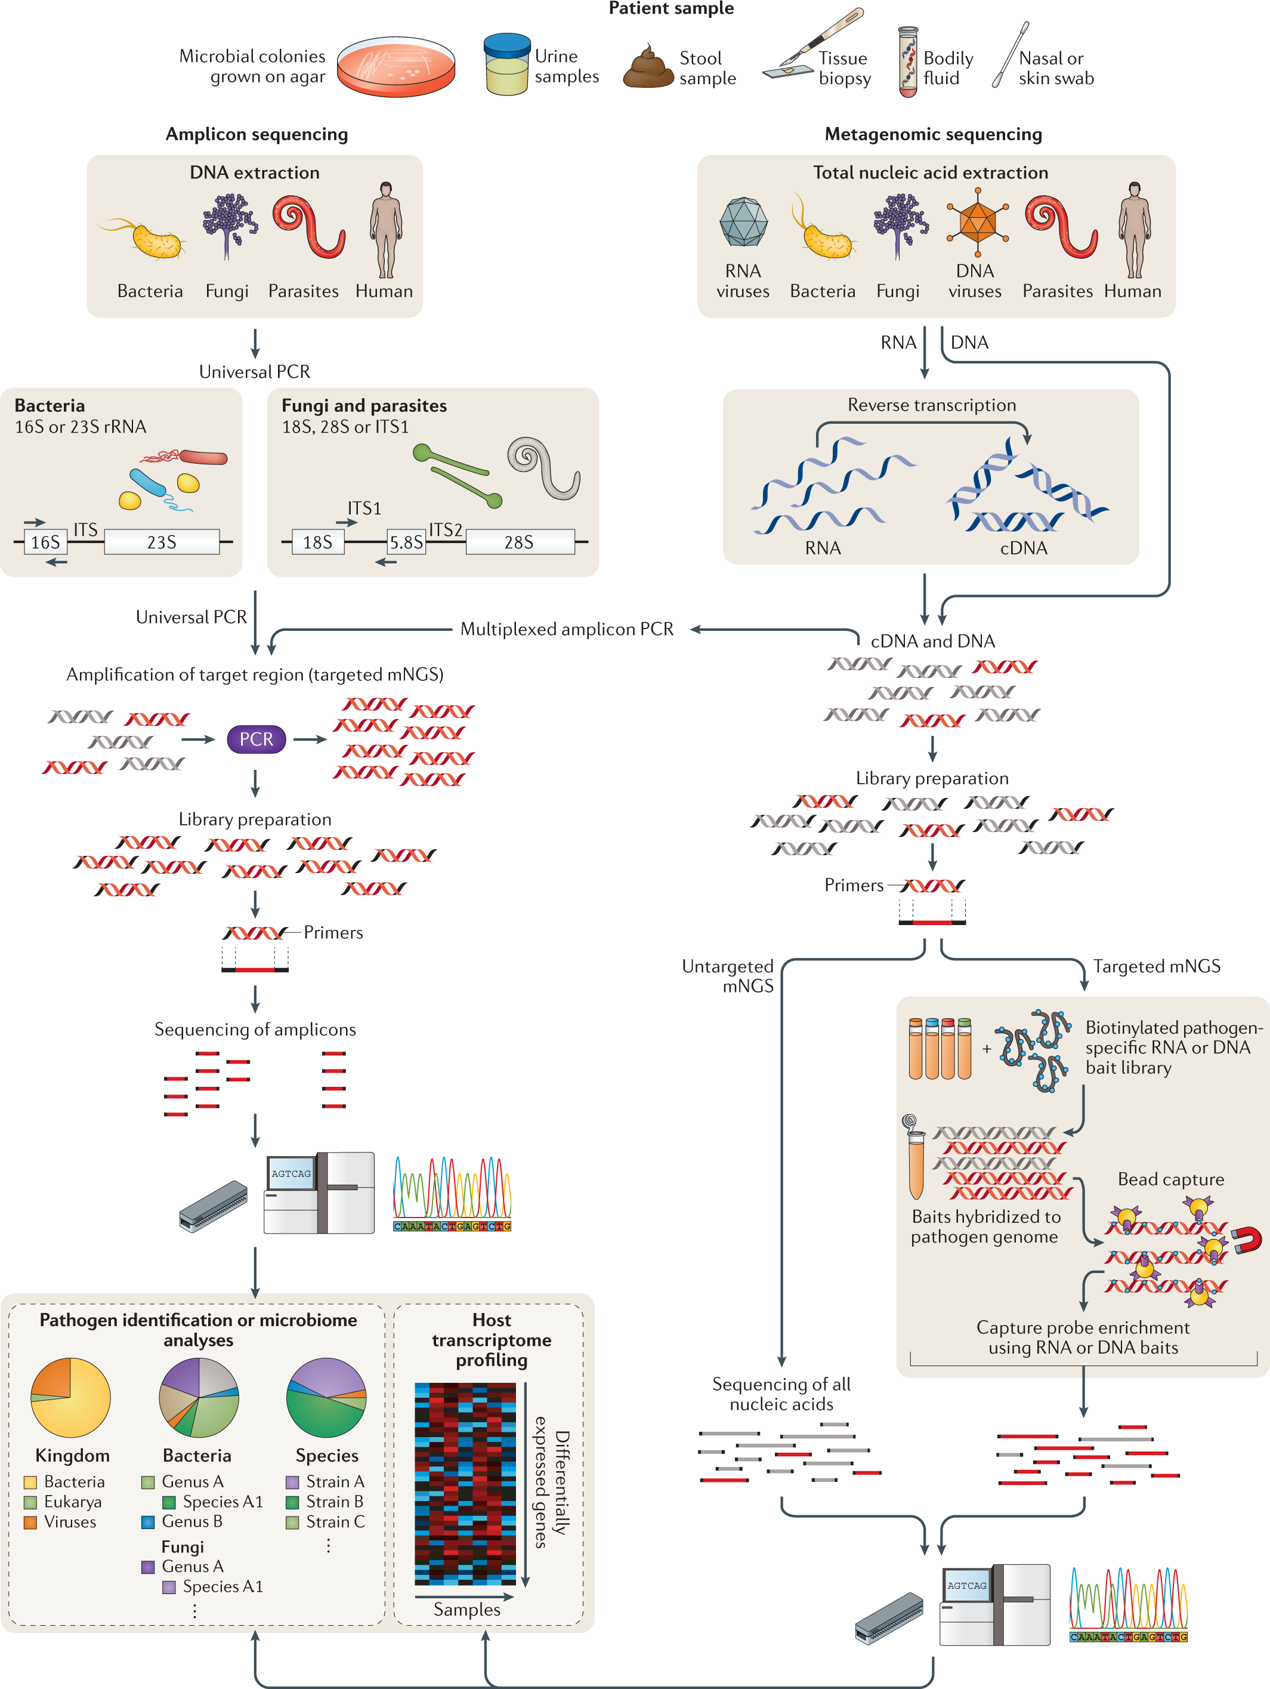
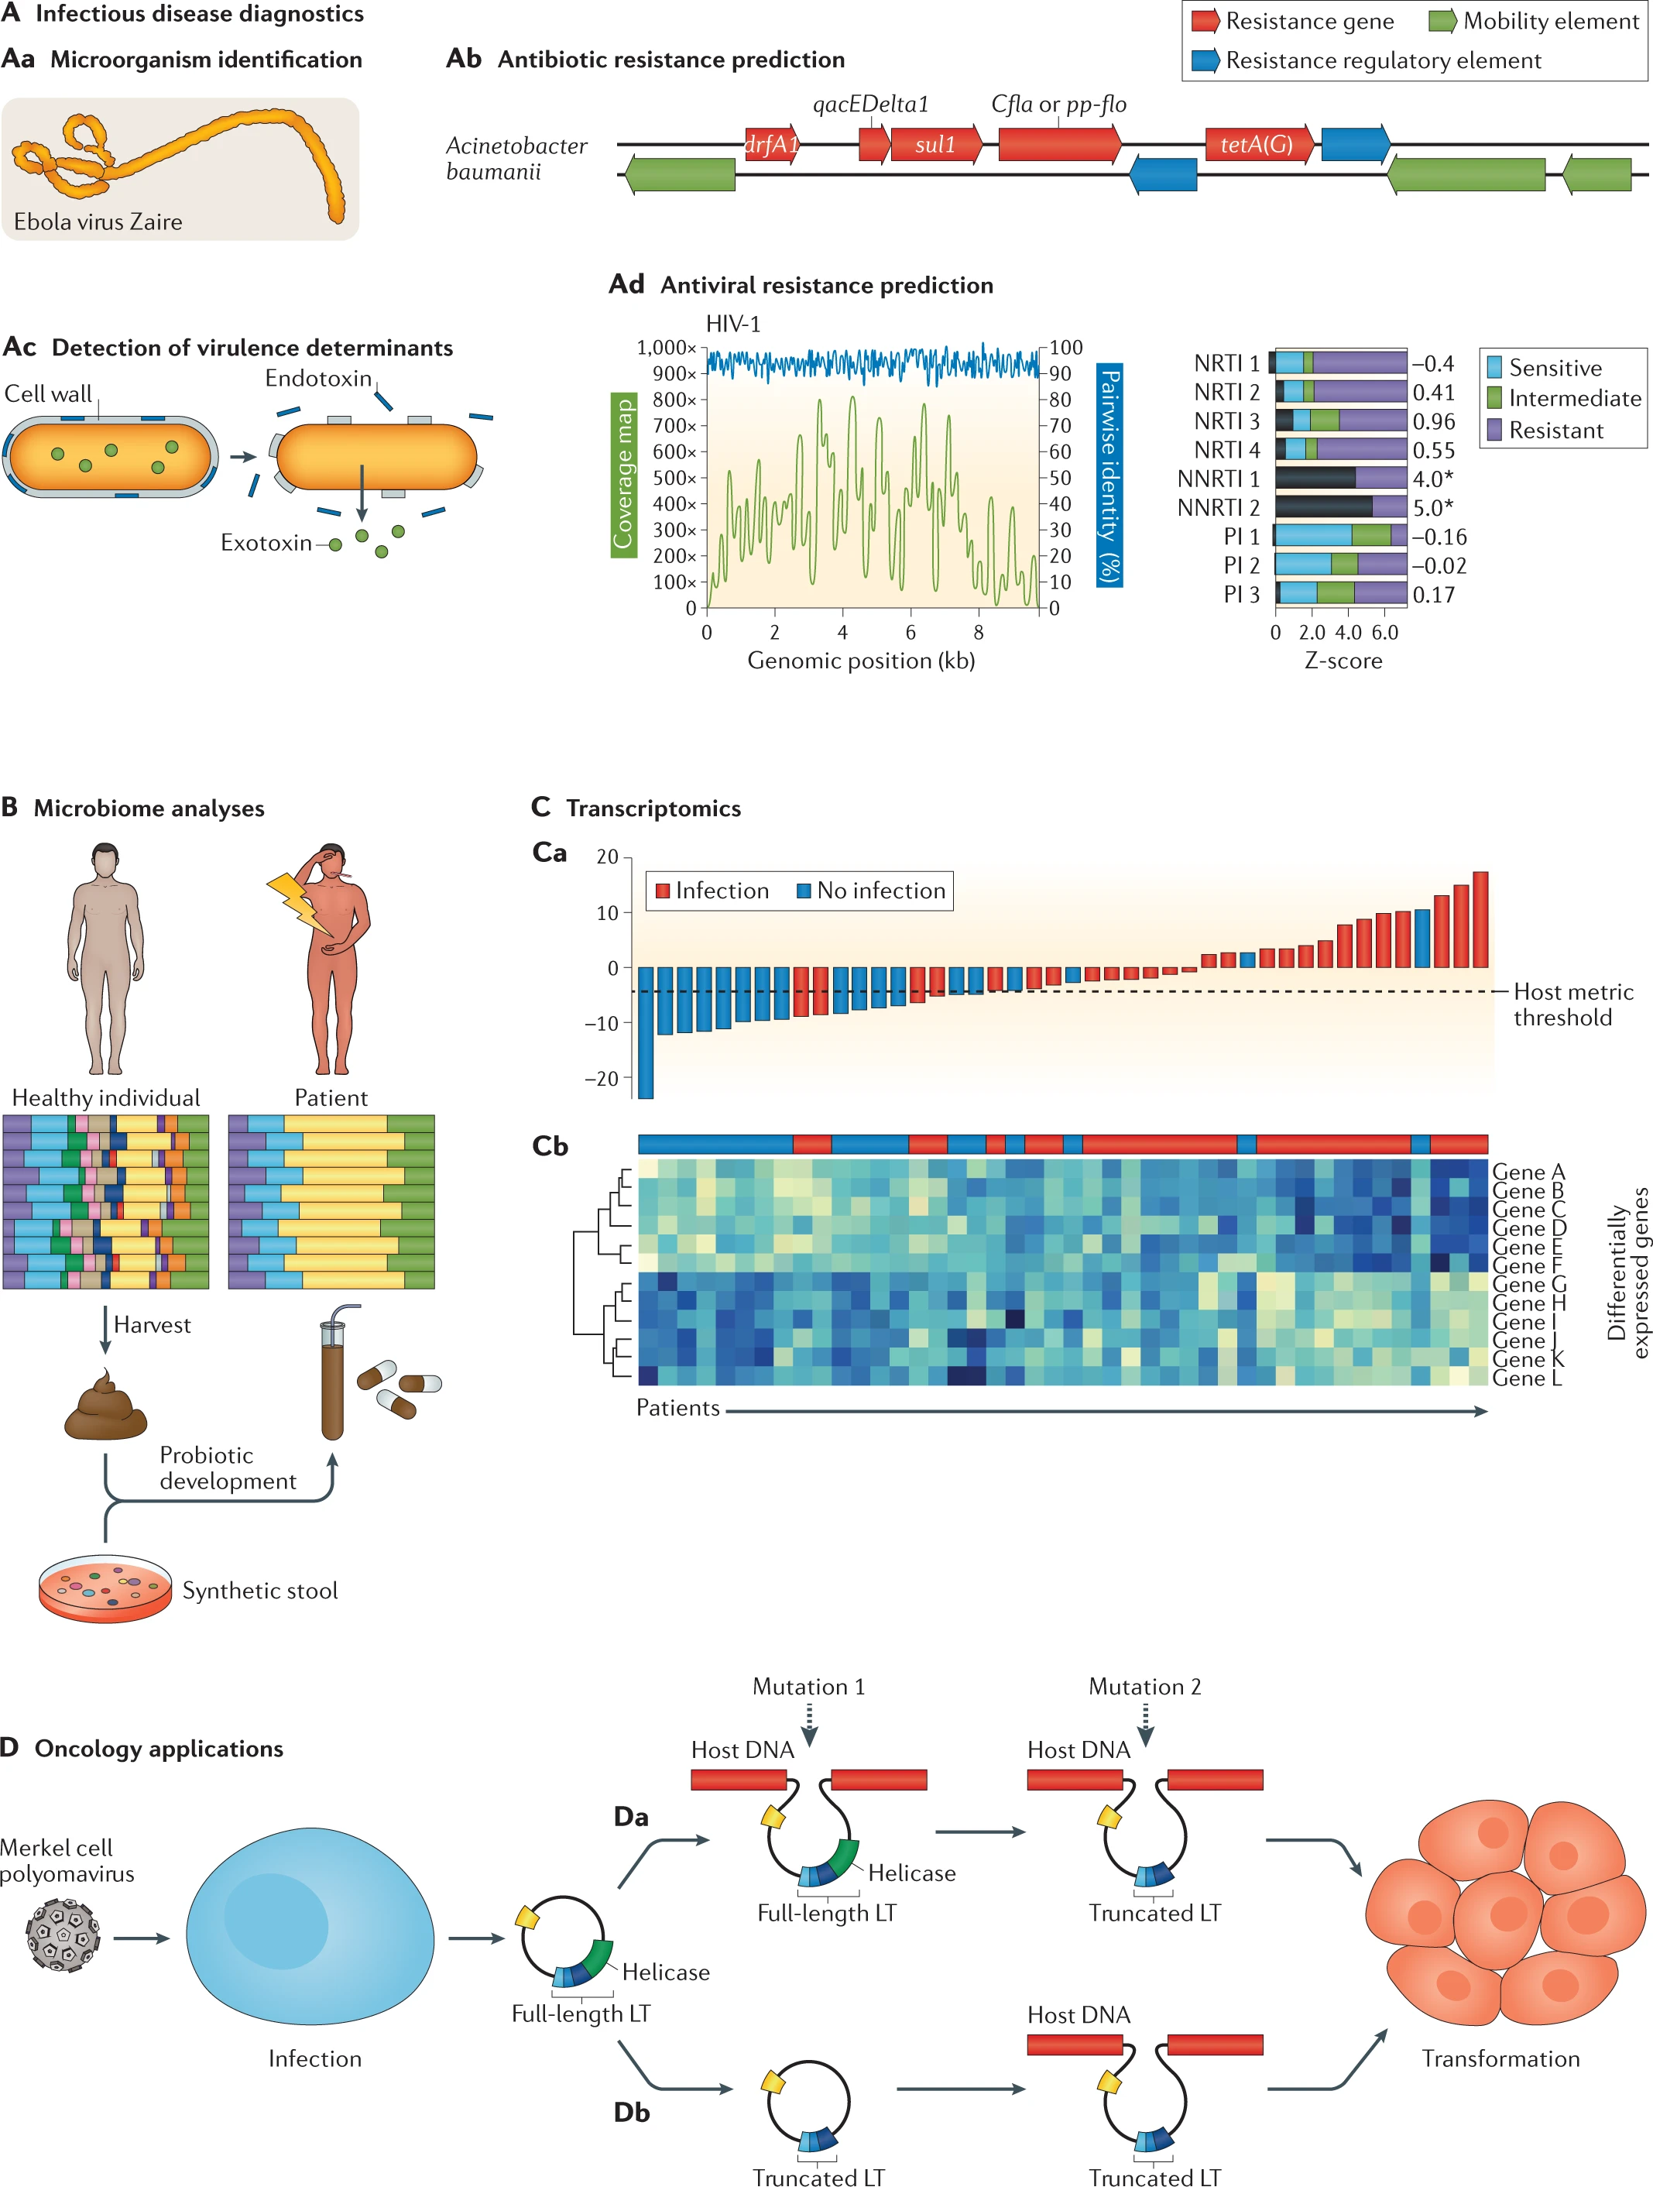
Metagenomic analysis
Chiu, C.Y., Miller, S.A. Clinical metagenomics. Nat Rev Genet 20, 341–355 (2019). https://doi.org/10.1038/s41576-019-0113-7

Slide 5
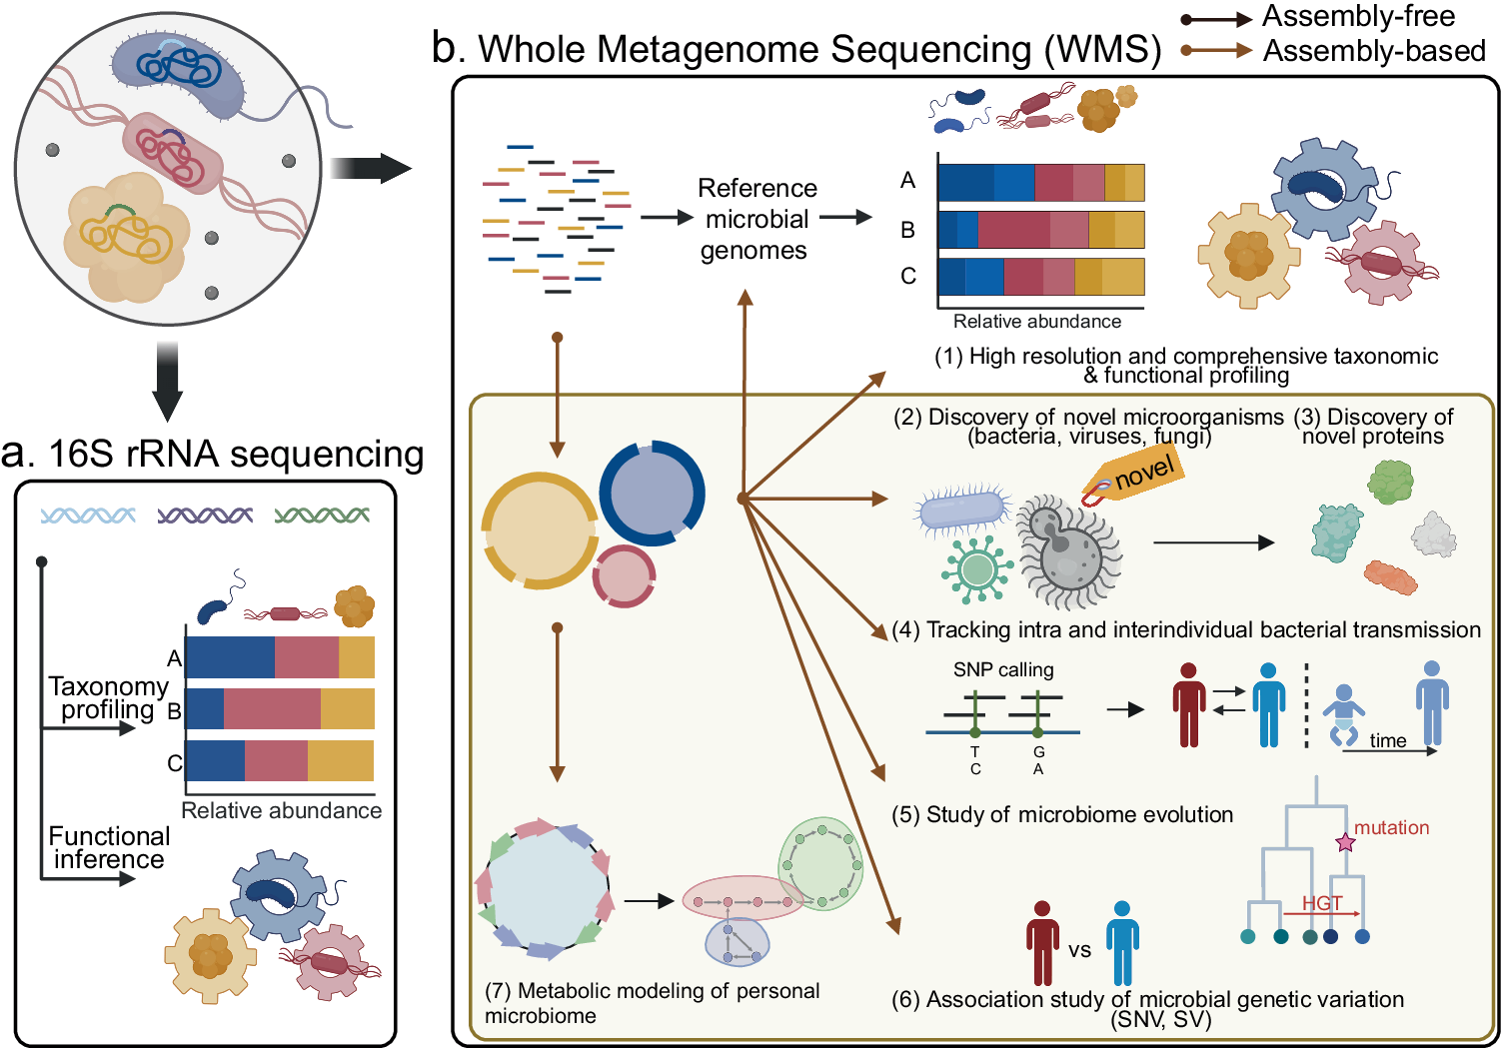
Metagenomic analysis pipeline
Kim, N., Ma, J., Kim, W. et al. Genome-resolved metagenomics: a game changer for microbiome medicine. Exp Mol Med 56, 1501–1512 (2024). https://doi.org/10.1038/s12276-024-01262-7

Slide 6
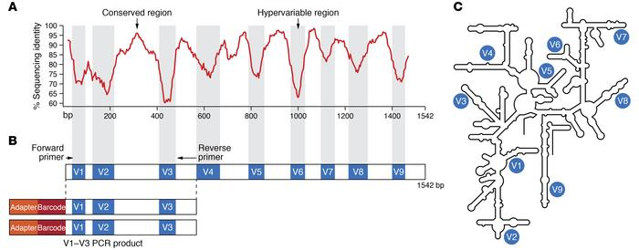
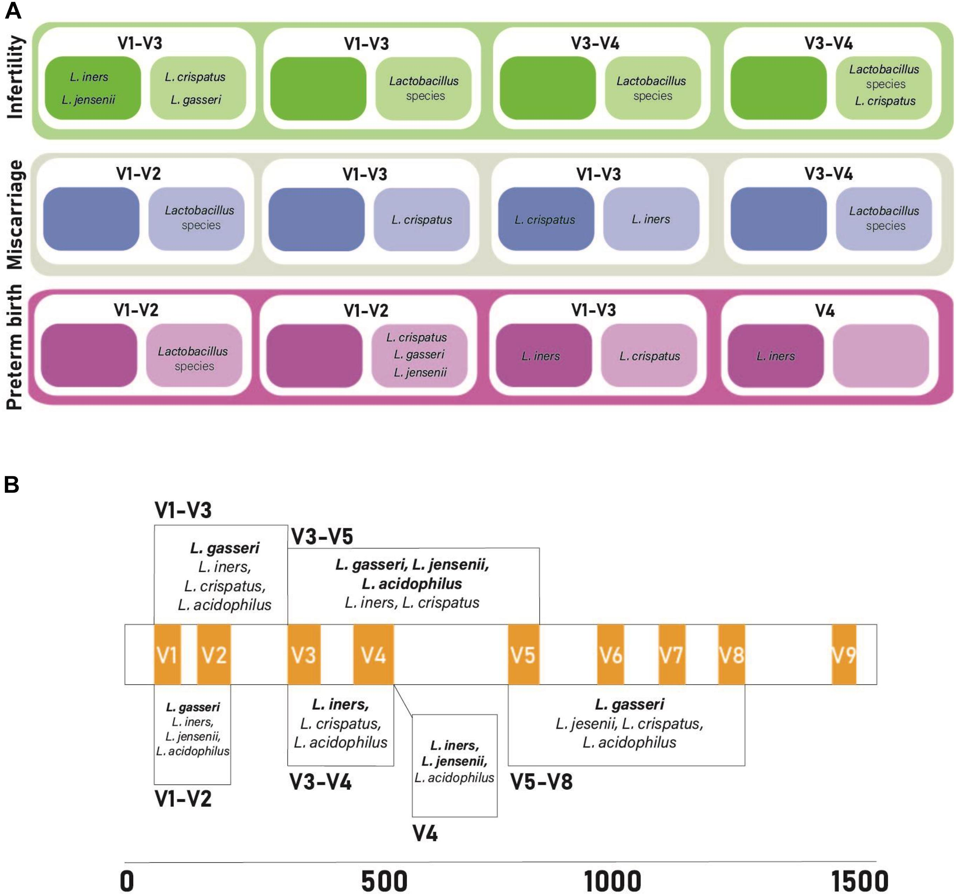
16s ribosomal RNA-based metagenomics
Limitation of 16s rRNA seq
O’Callaghan, J. L., et al. (2021). "Limitations of 16S rRNA Gene Sequencing to Characterize Lactobacillus Species in the Upper Genital Tract." Frontiers in Cell and Developmental Biology Volume 9 - 2021.

Slide 7
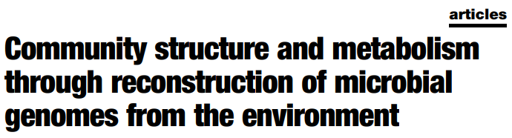
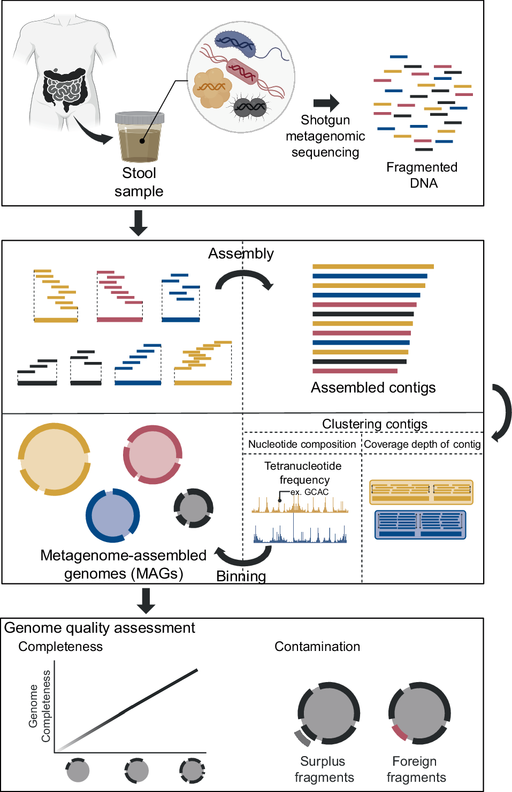
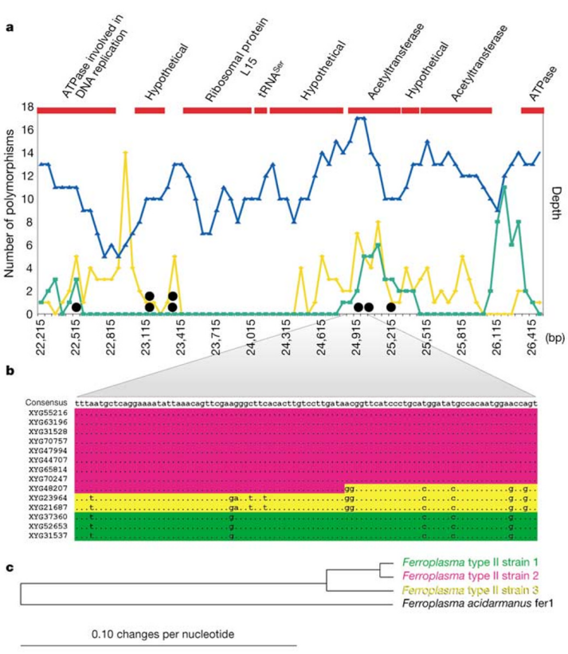
Metagenomic Assembled Genome (MAG)
2004 Nature
Tyson, G., Chapman, J., Hugenholtz, P. et al. Community structure and metabolism through reconstruction of microbial genomes from the environment. Nature 428, 37–43 (2004). https://doi.org/10.1038/nature02340

Slide 8
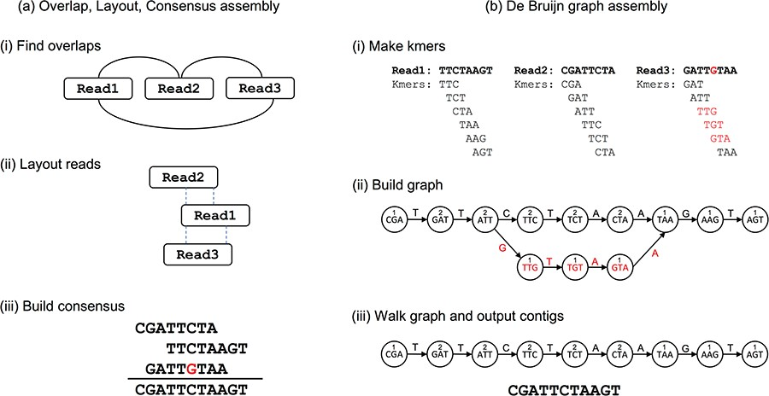
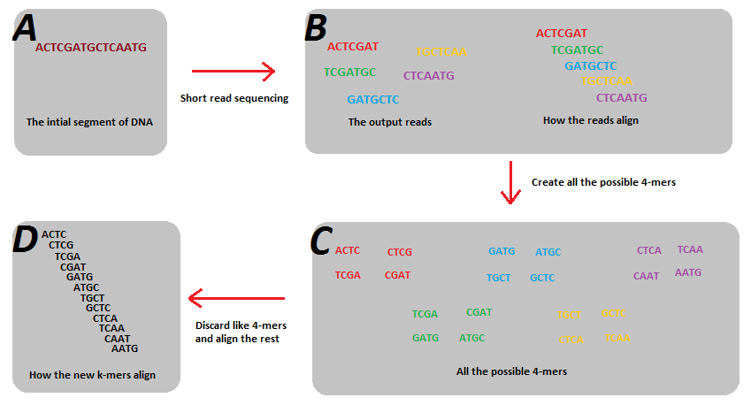
Contig-assembly (1)

Slide 9
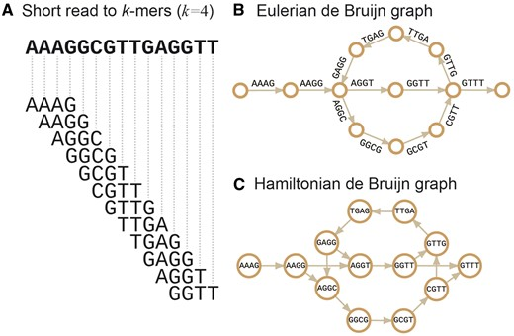
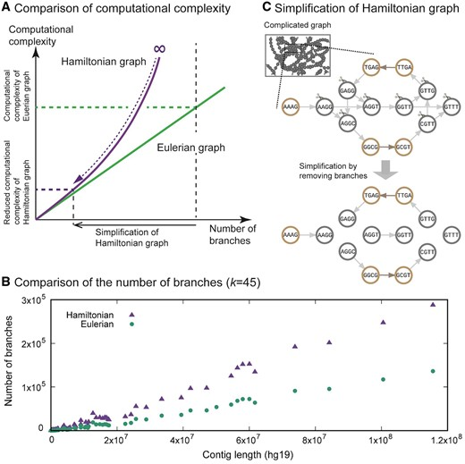
Contig-assembly (1)
AAAG
AAGG
AGGT
or
AAGG
Prefix: AAG
Suffix: AGG
AGGT
Prefix: AGG
Suffix: GGT
AGGC
Prefix: AGG
Suffix: GGC
GGCG
Prefix: GGC
Suffix: GCG

Slide 10
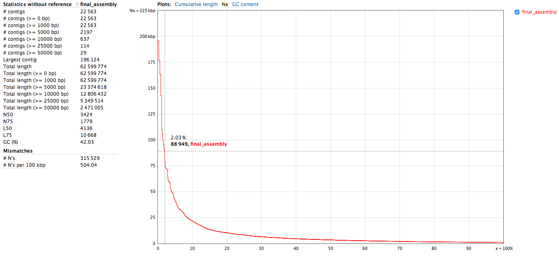
Contig-assembly (1)

Slide 11
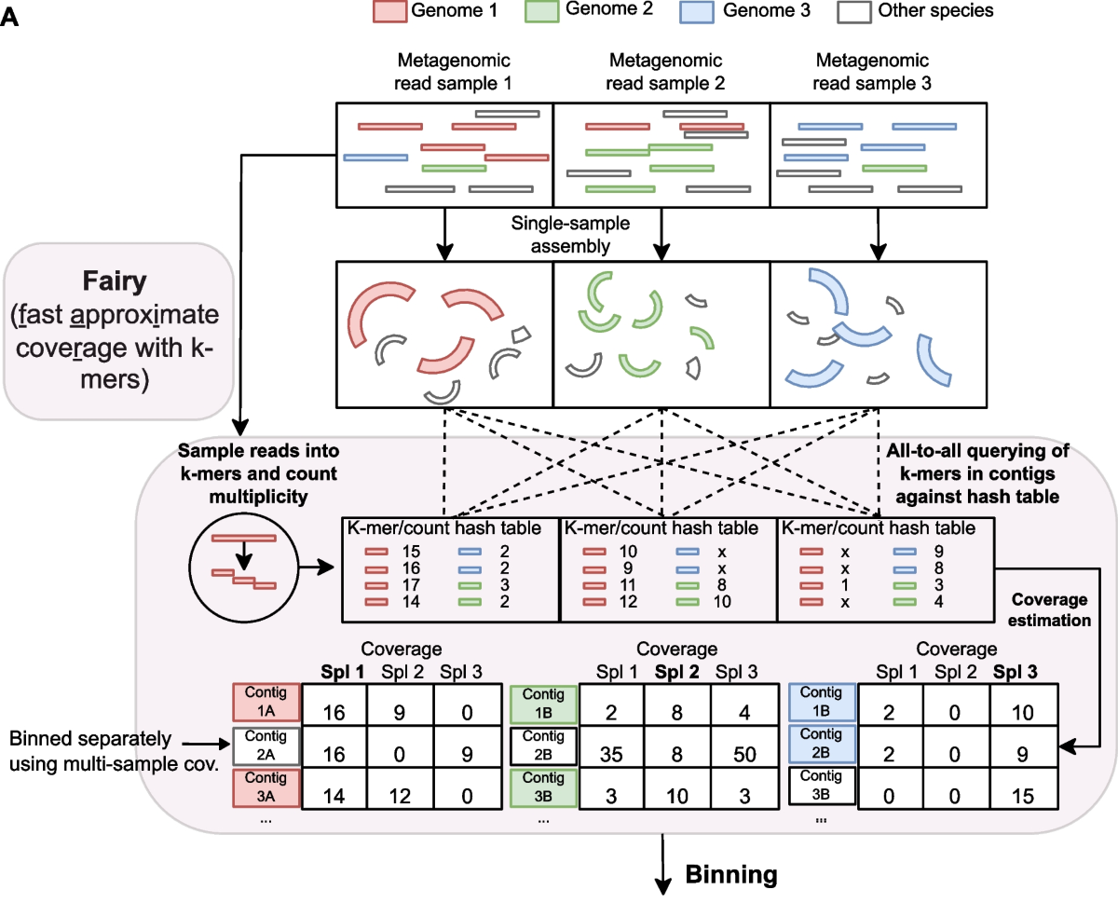
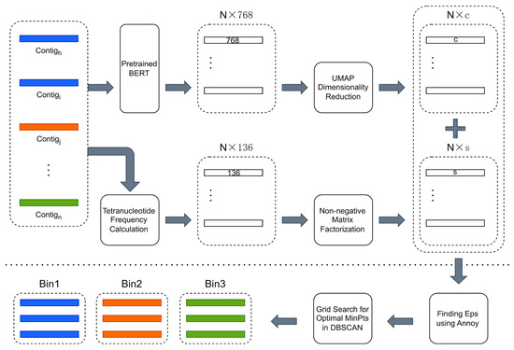
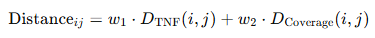
Binning (2)
Sequence structure-based clustering (tetranucleotide frequency space)
Coverage based binning
Fu, L.; Shi, J.; Huang, B. Binning Metagenomic Contigs Using Contig Embedding and Decomposed Tetranucleotide Frequency. Biology 2024, 13, 755. https://doi.org/10.3390/biology13100755

Slide 12
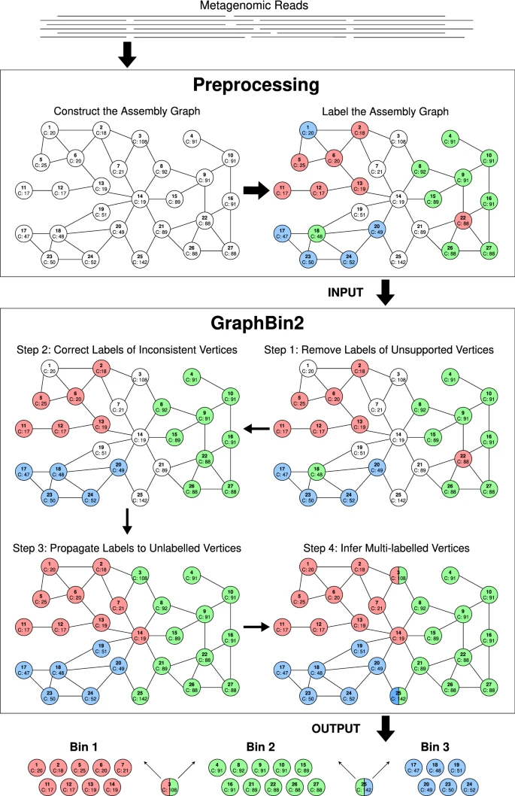
Binning (2)
*single copy marker gene-, VAE-binning methods are available

Slide 13
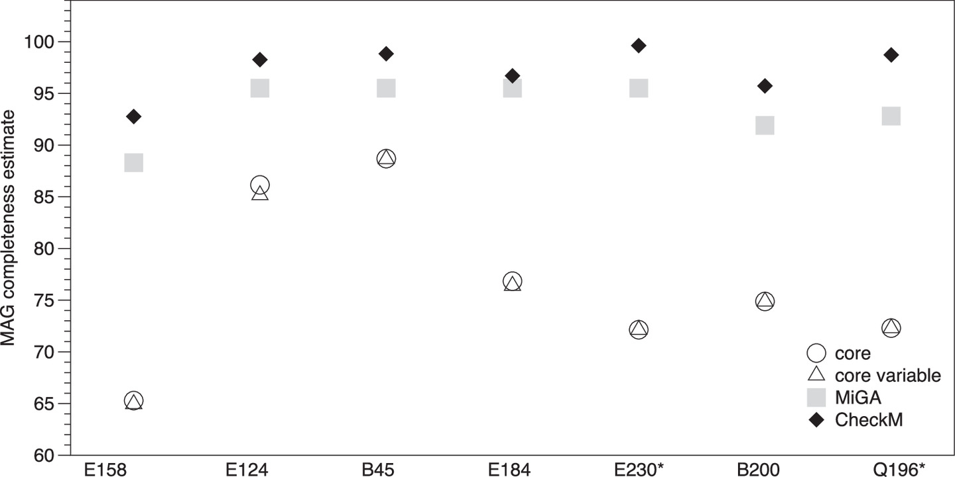
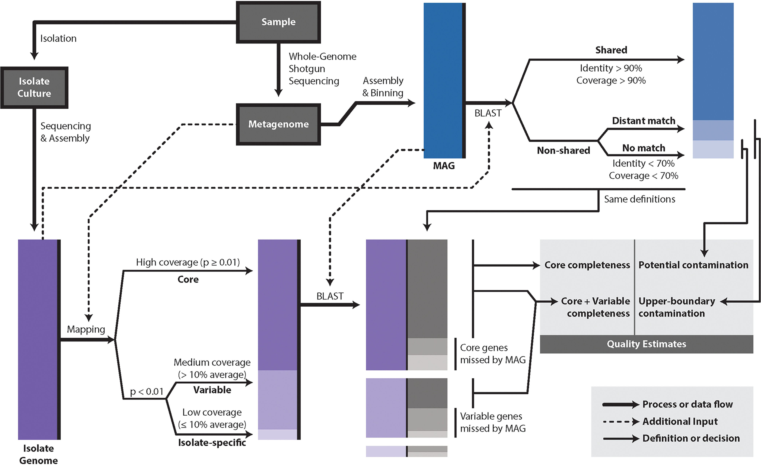
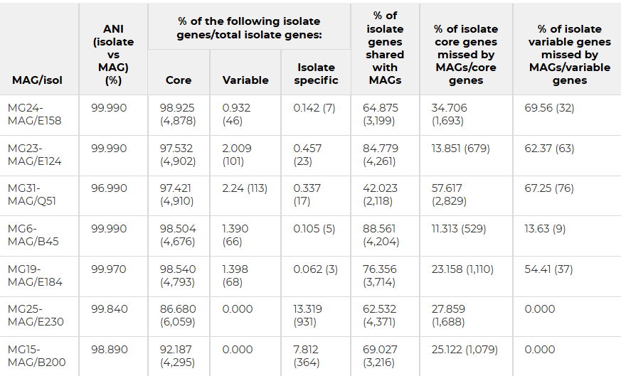
Similarity between metagenomic assembled genome and isolates genomes
How reliably do metagenome-assembled genomes (MAGs) represent natural populations? Insights from comparing MAGs against isolate genomes derived from the same fecal sample, 10.1128/AEM.02593-20 Applied and Environmental Microbiology

Slide 14


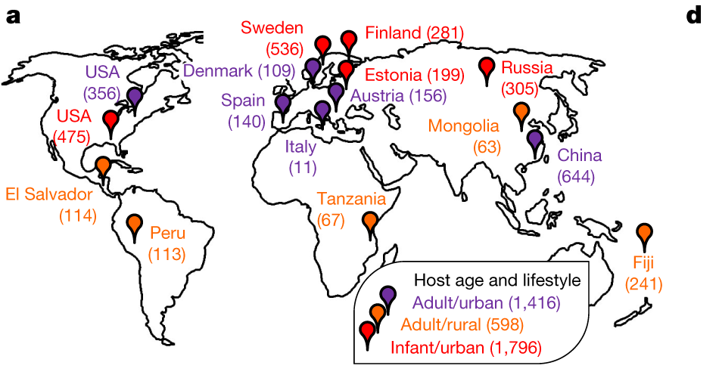
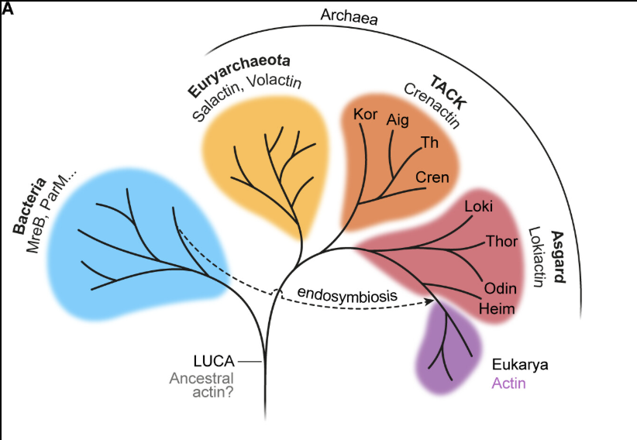
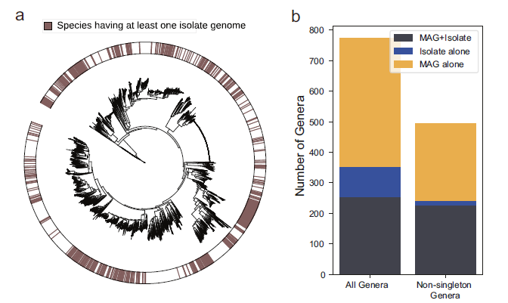
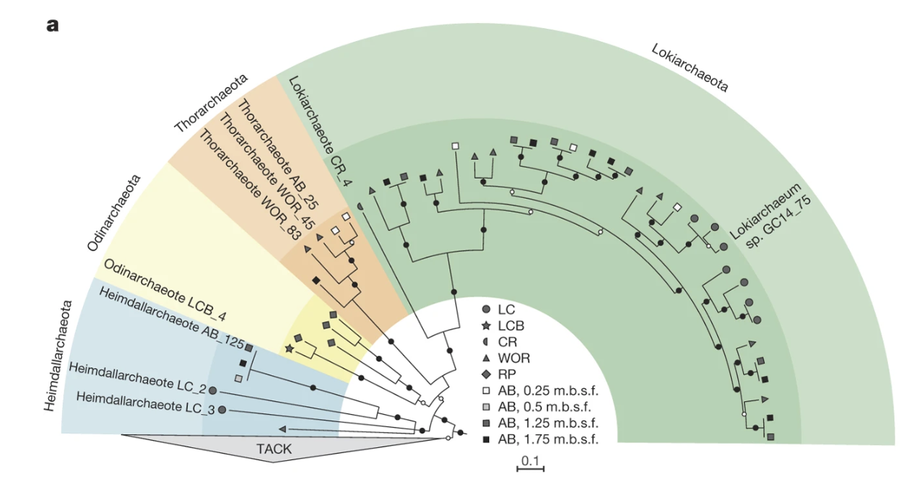
MAG application on microbiome field
Spang, A., Saw, J., Jørgensen, S. et al. Complex archaea that bridge the gap between prokaryotes and eukaryotes. Nature 521, 173–179 (2015). https://doi.org/10.1038/nature14447

Slide 15
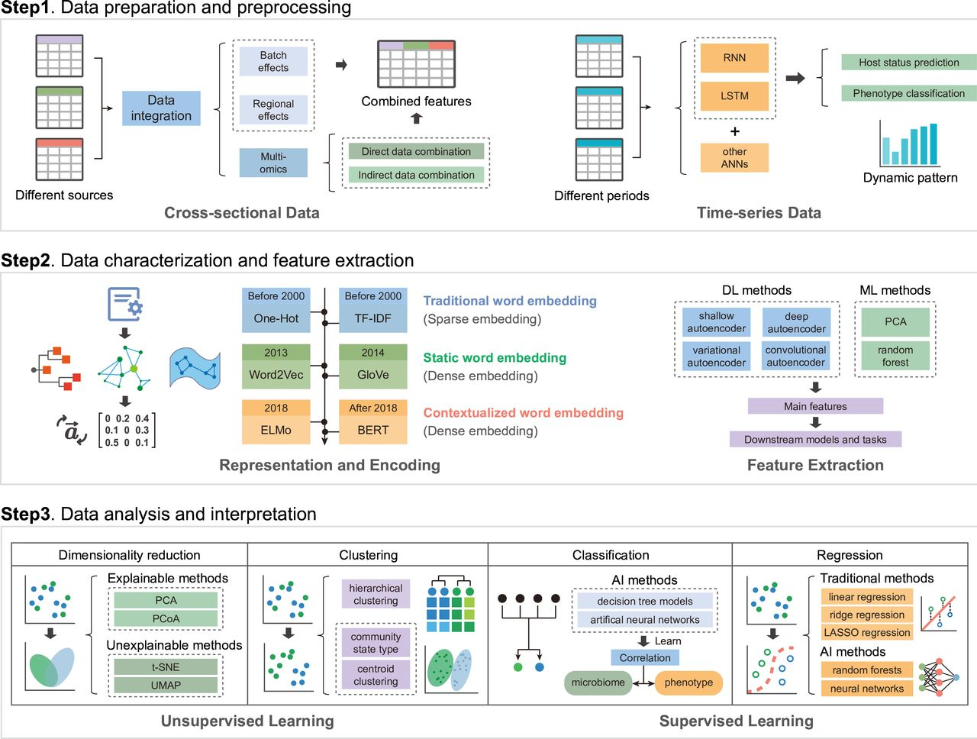
AI-driven microbiome data analysis

Slide 16
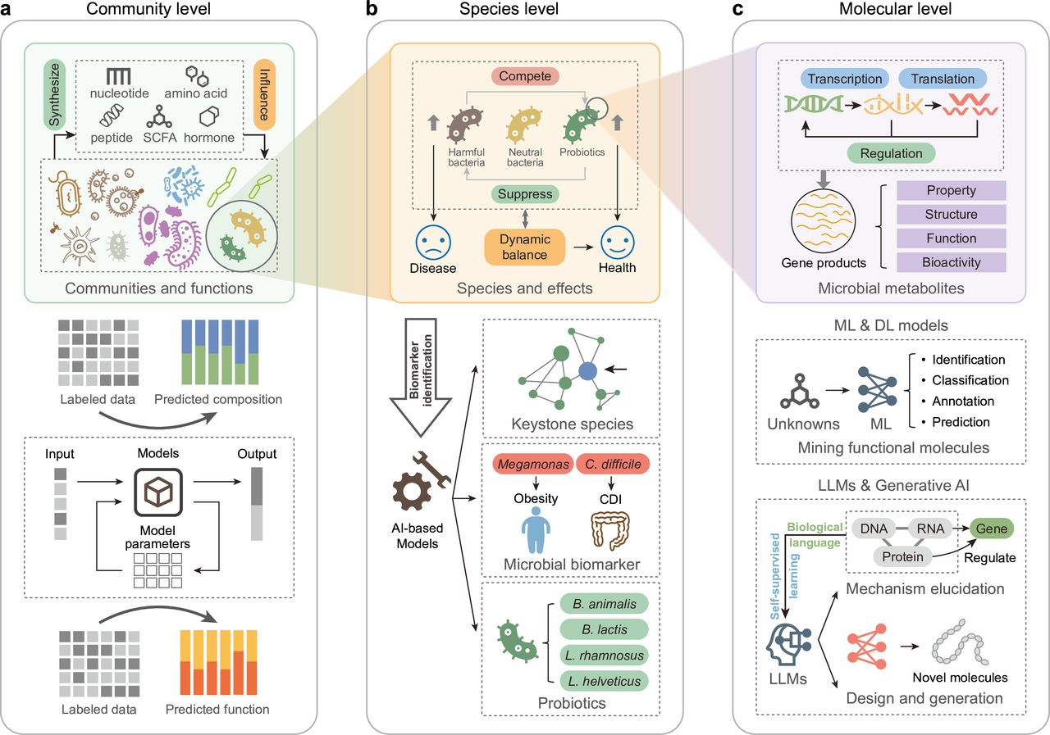
AI-driven microbiome data mining

Slide 17
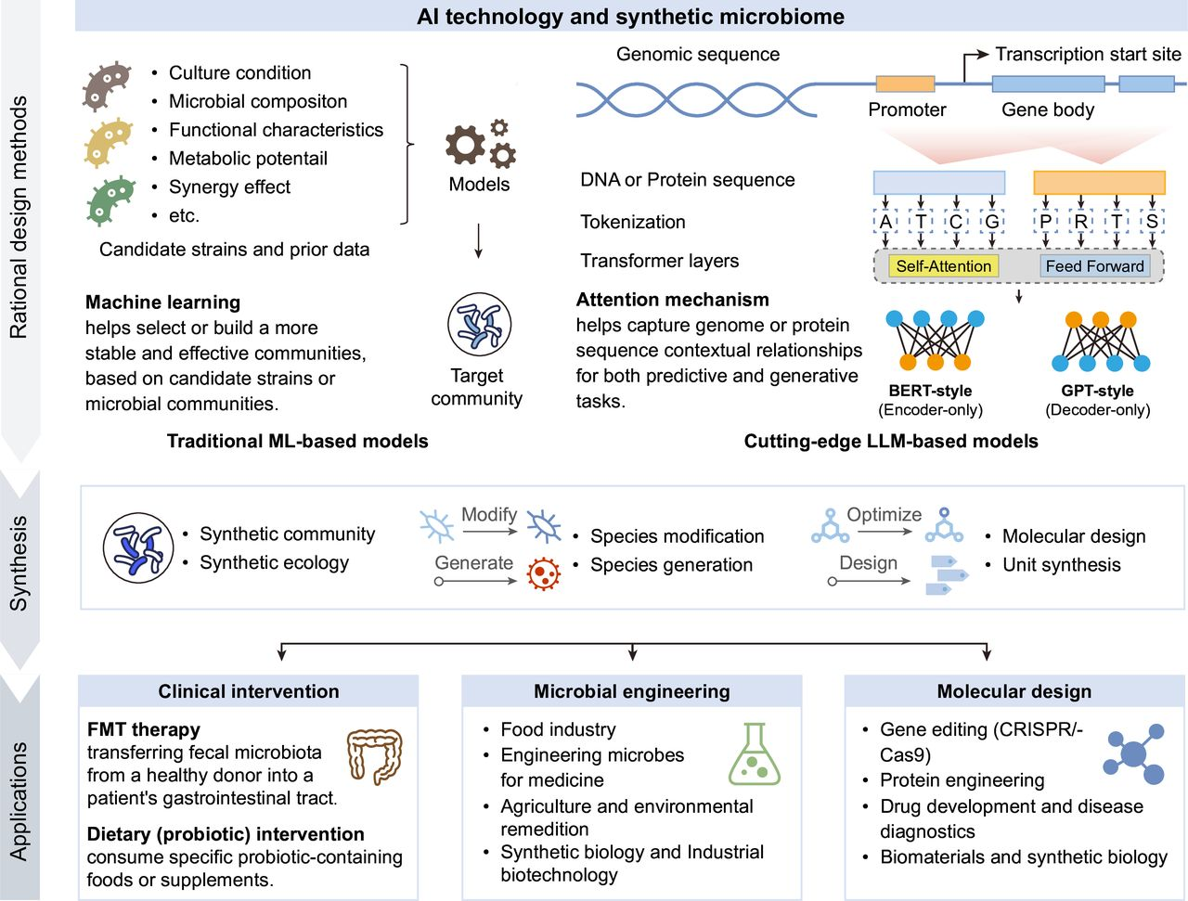
AI-driven synthetic microbiome

Slide 18
Thank you! Happy new year!

Slide 19
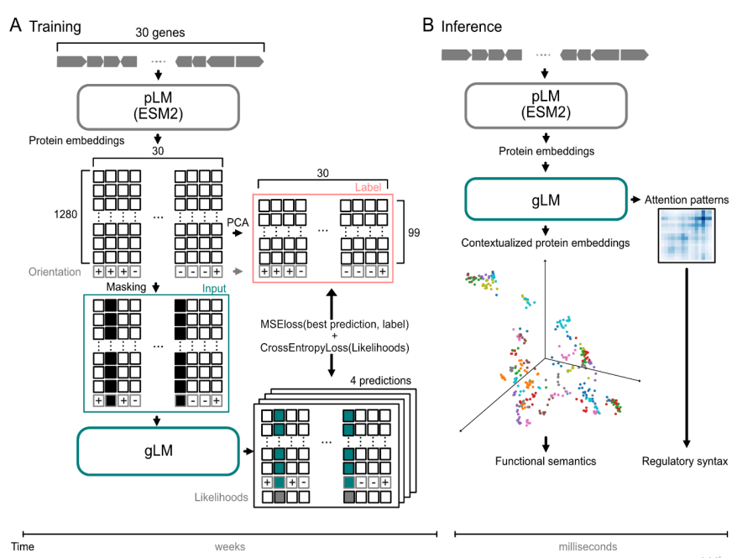
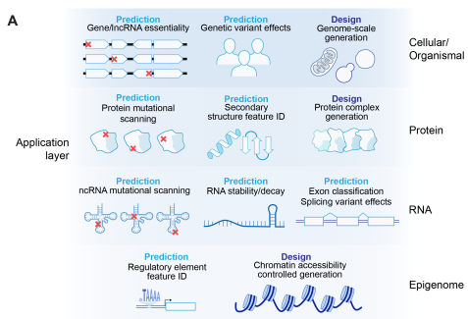
BERT

